Slide 1
Figures – Chapter 7

Slide 2
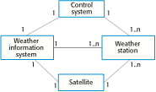
Figure 7.1 System context for the weather station

Slide 3
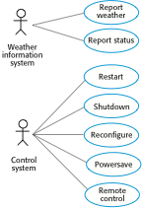
Figure 7.2 Weather station use cases

Slide 4
Figure 7.3 Use case description—Report weather
System | Weather station
Use case | Report weather
Actors | Weather information system, Weather station
Description | The weather station sends a summary of the weather data that has been collected from the instruments in the collection period to the weather information system. The data sent are the maximum, minimum, and average ground and air temperatures; the maximum, minimum, and average air pressures; the maximum, minimum, and average wind speeds; the total rainfall; and the wind direction as sampled at five-minute intervals.
Stimulus | The weather information system establishes a satellite communication link with the weather station and requests transmission of the data.
Response | The summarized data is sent to the weather information system.
Comments | Weather stations are usually asked to report once per hour but this frequency may differ from one station to another and may be modified in the future.

Slide 5
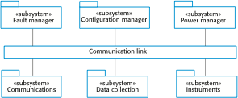
Figure 7.4 High-level architecture of the weather station

Slide 6
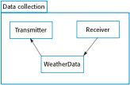
Figure 7.5 Architecture of data collection system

Slide 7
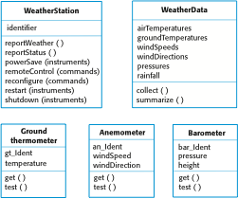
Figure 7.6 Weather station objects

Slide 8
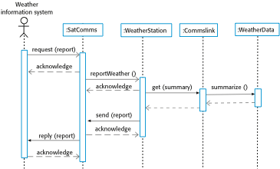
Figure 7.7 Sequence diagram describing data collection

Slide 9
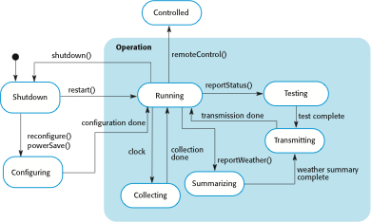
Figure 7.8 Weather station state diagram

Slide 10

Figure 7.9 Weather station interfaces

Slide 11
Figure 7.10 The Observer pattern
Pattern name | Observer
Description | Separates the display of the state of an object from the object itself and allows alternative displays to be provided. When the object state changes, all displays are automatically notified and updated to reflect the change.
Problem description | In many situations, you have to provide multiple displays of state information, such as a graphical display and a tabular display. Not all of these may be known when the information is specified. All alternative presentations should support interaction and, when the state is changed, all displays must be updated. This pattern may be used in all situations where more than one display format for state information is required and where it is not necessary for the object that maintains the state information to know about the specific display formats used.
Solution description | This involves two abstract objects, Subject and Observer, and two concrete objects, ConcreteSubject and ConcreteObject, which inherit the attributes of the related abstract objects. The abstract objects include general operations that are applicable in all situations. The state to be displayed is maintained in ConcreteSubject, which inherits operations from Subject allowing it to add and remove Observers (each observer corresponds to a display) and to issue a notification when the state has changed. The ConcreteObserver maintains a copy of the state of ConcreteSubject and implements the Update() interface of Observer that allows these copies to be kept in step. The ConcreteObserver automatically displays the state and reflects changes whenever the state is updated. The UML model of the pattern is shown in Figure 7.12.
Consequences | The subject only knows the abstract Observer and does not know details of the concrete class. Therefore there is minimal coupling between these objects. Because of this lack of knowledge, optimizations that enhance display performance are impractical. Changes to the subject may cause a set of linked updates to observers to be generated, some of which may not be necessary.

Slide 12
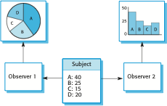
Figure 7.11 Multiple displays

Slide 13
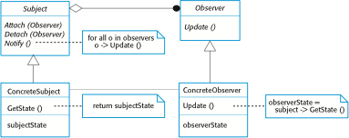
Figure 7.12 A UML model of the Observer pattern

